Slide 1
Lecture 2 Entity-Relationship Model Modeling
Design Process
Entity Sets
Attributes
Relationship Sets

Slide 2
Outline
Design Process
Entity Sets
Attributes
Relationship Sets
Design Process
Entity Sets
Attributes
Relationship Sets

Slide 3
Design Process
Design Process
Entity Sets
Attributes
Relationship Sets
In general, the goal of the relational database design is to create a database in a specific database management system that allows us to
store all information that we want,
minimize unnecessary redundancies, and
let users search information easily.
However, database design for an application is a complex task.
It is split into multiple phases.
1. Conceptual Design
2. Logical Design
3. Optimization
4. Physical Design

Slide 4
Design Process
Design Process
Entity Sets
Attributes
Relationship Sets
The first phase of the design process is conceptual-design.
At this stage, designers focus on describing data and their relationships.
The entity-relationship model (ER model) is introduced in this course.
The outcome of this phase is an ER diagram.
It provides a graphic representation of the database design.
name
name
category
price
Product
Makes
Company

Slide 5
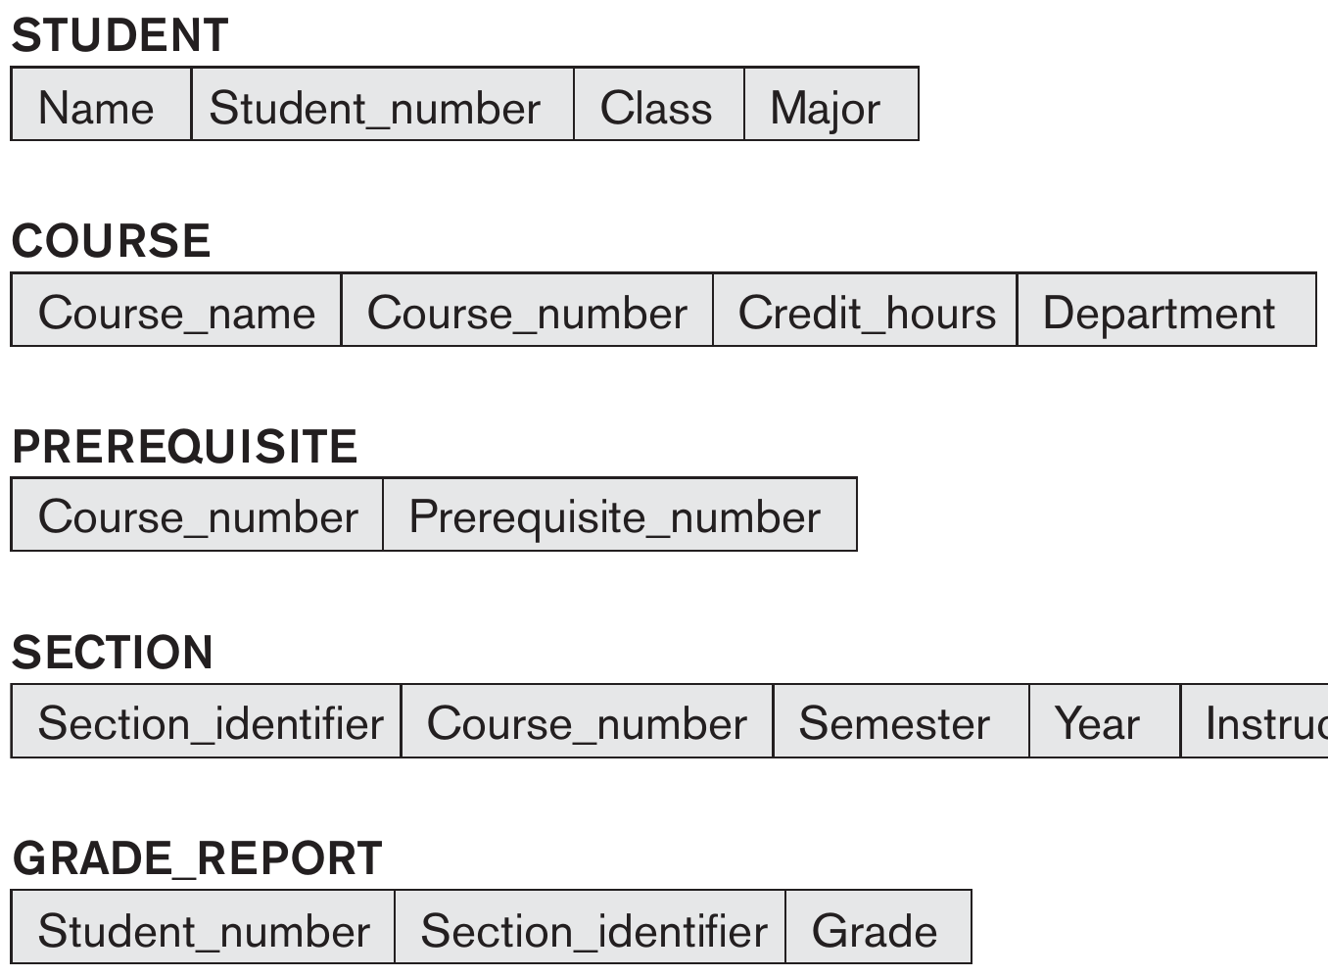
Design Process
Design Process
Entity Sets
Attributes
Relationship Sets
The next phase is to convert an ER diagram to the implementation data model of the database system that will be used.
In this course, we will introduce the relational data model.
Thus, relational schemas will be produced after this phase.
In general, relational schemas are some descriptions for the data which is modeled in an application.
The relational schemas of a database are called logical view.
So, this phase is the logical-design phase.

Slide 6
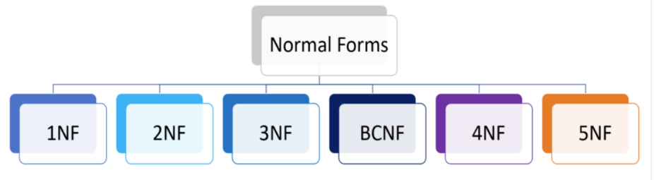
Design Process
Design Process
Entity Sets
Attributes
Relationship Sets
After the second phase, the designer has several relational schemas.
However, the relational schemas may not be perfect and contain redundancies, because the ER diagram is very subjective.
Then, the next phase is optimizing the logical design using functional dependencies and normal forms.
The optimization will be introduced in the chapter Database Design.

Slide 7
Design Process
Design Process
Entity Sets
Attributes
Relationship Sets
The final phase will be the physical-design phase.
Designers will implement the optimized relational schemas in the database management system using a particular data definition language.
SQL will be introduced in this course.
After the implementation, the design of a database is finished.
Users can load data into the database.
Then, users can manipulate data and develop database applications.

Slide 8
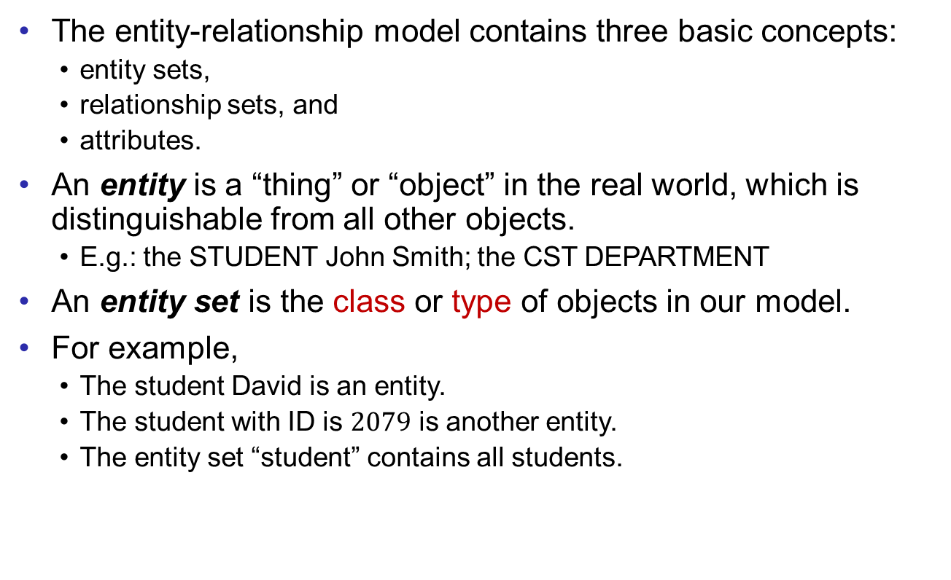
Entity Set
Design Process
Entity Sets
Attributes
Relationship Sets
The entity-relationship model contains three basic concepts:
entity sets,
relationship sets, and
attributes.
An entity is a “thing” or “object” in the real world, which is distinguishable from all other objects.
E.g.: the STUDENT John Smith; the CST DEPARTMENT
An entity set is the class or type of objects in our model.
For example,
The student David is an entity.
The student with ID is $2079$ is another entity.
The entity set “student” contains all students.

Slide 9
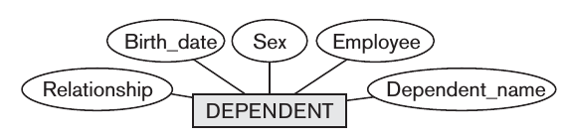
Attribute
Design Process
Entity Sets
Attributes
Relationship Sets
An entity can be described by a set of properties.
Each property is an attribute of the entity.
A set of attributes describes and distinguishes the entities in the same entity set.
One entity can have different attributes in different models for different applications.
E.g. in SAO’s database, room number is an attribute for student, while AR database is more interested in his GPA instead.

Slide 10
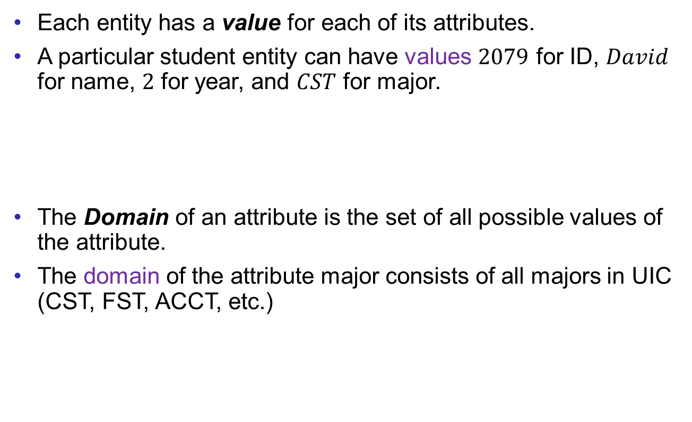
Attribute
Design Process
Entity Sets
Attributes
Relationship Sets
Each entity has a value for each of its attributes.
A particular student entity can have values $2079$ for ID, $David$ for name, $2$ for year, and $CST$ for major.
The Domain of an attribute is the set of all possible values of the attribute.
The domain of the attribute major consists of all majors in UIC (CST, FST, ACCT, etc.)

Slide 11
Basic ER Features
Design Process
Entity Sets
Attributes
Relationship Sets
In ER diagrams,
rectangles represent entity sets;
ellipses represent attributes;
keys are underlined; and
lines link attributes to entity sets.
For example, the student entity set is modeled as follows.
id
name
student
year
major
GPA

Slide 12
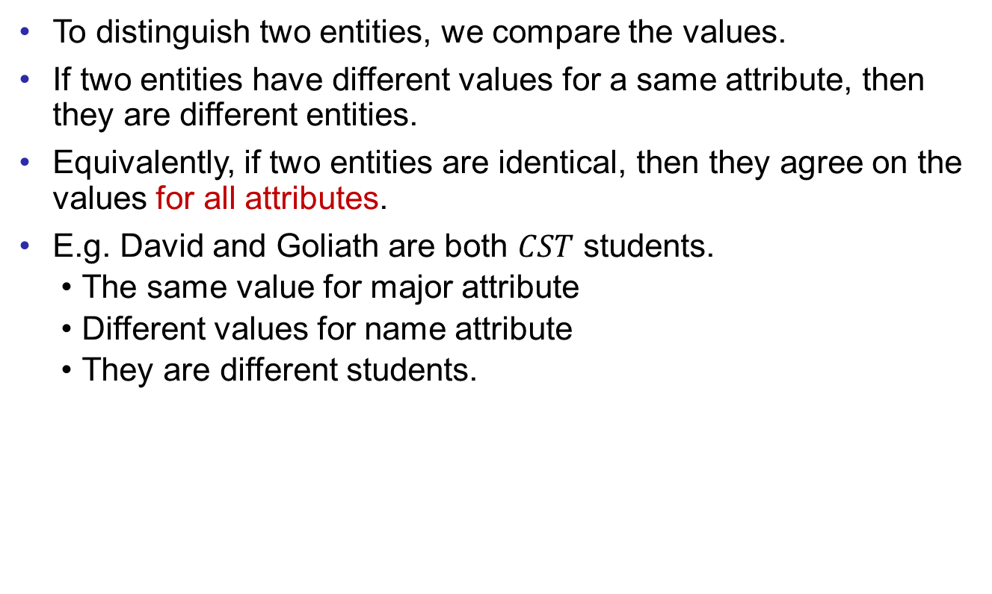
Key
Design Process
Entity Sets
Attributes
Relationship Sets
To distinguish two entities, we compare the values.
If two entities have different values for a same attribute, then they are different entities.
Equivalently, if two entities are identical, then they agree on the values for all attributes.
E.g. David and Goliath are both $CST$ students.
The same value for major attribute
Different values for name attribute
They are different students.
ID
name
major
Student

Slide 13

Key
Design Process
Entity Sets
Attributes
Relationship Sets
To test if two entities are identical, we can check all attributes.
But this is not efficient.
In most cases, if two entities have the same value for one or some special attributes, then we can sufficiently claim that the two entities are the same.
The set of special attribute(s) is called key.
Formally, a key of an entity set is a set of attributes that can uniquely identify the entities.
Two entities are identical if and only if they have the same value for the key.

Slide 14
Key
Design Process
Entity Sets
Attributes
Relationship Sets
For example, each student is described by ID, name, year, major, and GPA.
In the real-world, two students may have the same name, year, major, and even GPA. But their student IDs have to be different.
The student ID can distinguish different students.
ID
name
major
GPA
Student
year

Slide 15
Multi-valued Attribute
Design Process
Entity Sets
Attributes
Relationship Sets
Suppose that we also want to model students’ phone number.
It is possible that one student may have multiple phone numbers.
Thus, the phone number of a student is a multi-valued attribute, denoted by double ellipses.
id
name
phone
student
year
major
GPA

Slide 16
Example
Design Process
Entity Sets
Attributes
Relationship Sets
For more examples, instructor, course, and book are modeled in the same way.
id
name
course_name
ISBN
credits
phone
instructor
course
book
title
major
course_code
title
author
salary

Slide 17
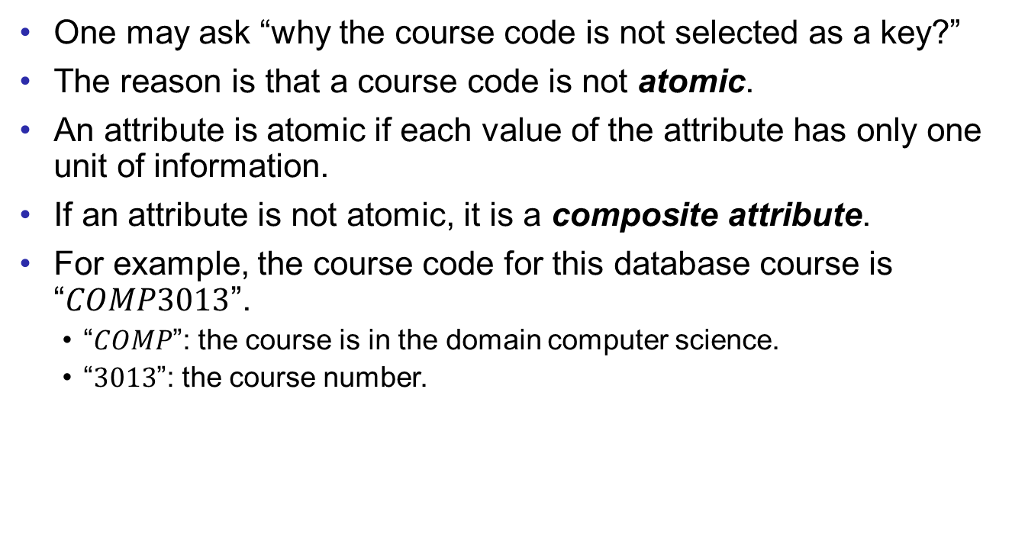
Composite Attribute
Design Process
Entity Sets
Attributes
Relationship Sets
One may ask “why the course code is not selected as a key?”
The reason is that a course code is not atomic.
An attribute is atomic if each value of the attribute has only one unit of information.
If an attribute is not atomic, it is a composite attribute.
For example, the course code for this database course is “$COMP3013$”.
“$COMP$”: the course is in the domain computer science.
“$3013$”: the course number.

Slide 18
Composite Attribute
Design Process
Entity Sets
Attributes
Relationship Sets
Thus, the attribute course code is decomposed into domain (offering unit) and course number.
course_name
credits
course
course_code
domain
course_number

Slide 19
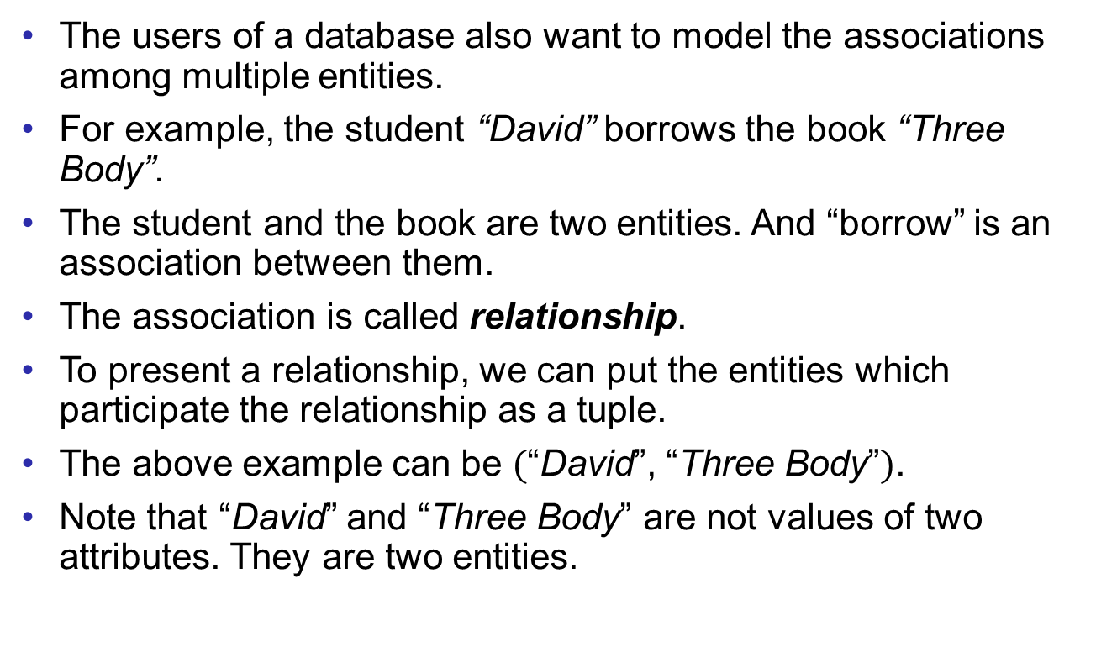
Relationship
Design Process
Entity Sets
Attributes
Relationship Sets
The users of a database also want to model the associations among multiple entities.
For example, the student “David” borrows the book “Three Body”.
The student and the book are two entities. And “borrow” is an association between them.
The association is called relationship.
To present a relationship, we can put the entities which participate the relationship as a tuple.
The above example can be $($“David”, “Three Body”$)$.
Note that “David” and “Three Body” are not values of two attributes. They are two entities.

Slide 20


Relationship Set
Design Process
Entity Sets
Attributes
Relationship Sets
A relationship set is a set of relationships of the same type.
For example, the relationship set “borrow” describes which student borrows which book.
The set of all links is the relationship set.
MacBeth
Alice
Ellen
Bob
Database
Cindy
Three Body
David
Student
Book

Slide 21
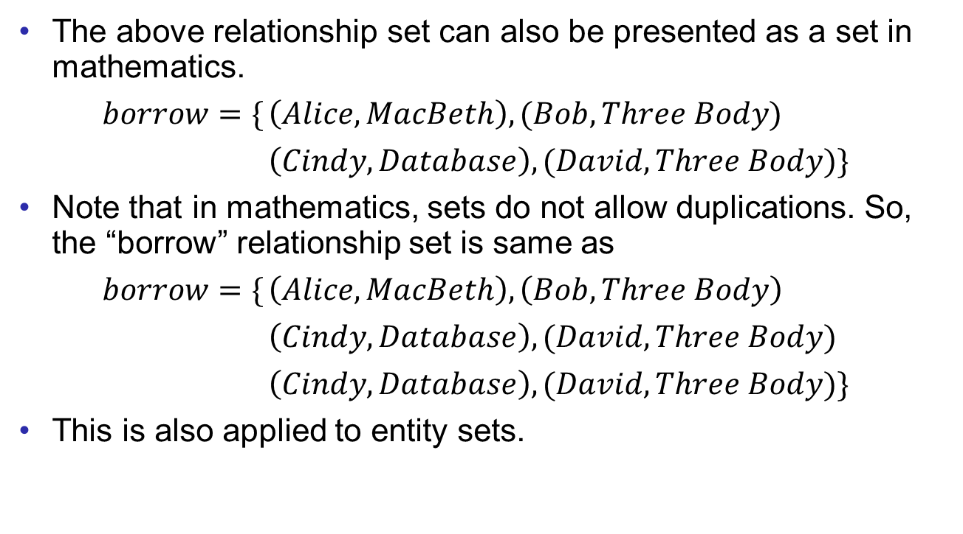
Relationship Set
Design Process
Entity Sets
Attributes
Relationship Sets
The above relationship set can also be presented as a set in mathematics.
$borrow=\{$ $\left(Alice,MacBeth\right),(Bob, Three Body)$
$\left(Cindy, Database\right),(David, Three Body)\}$
Note that in mathematics, sets do not allow duplications. So, the “borrow” relationship set is same as
$borrow=\{$ $\left(Alice, MacBeth\right),\left(Bob, Three Body\right)$
$\left(Cindy, Database\right),(David,Three Body)$
$\left(Cindy,Database\right),(David,Three Body)\}$
This is also applied to entity sets.

Slide 22
Relationship Set
Design Process
Entity Sets
Attributes
Relationship Sets
In ER diagrams, a relationship set is denoted by a diamond.
The previous example “students borrow books” can be modeled as
id
name
ISBN
phone
student
borrow
book
year
major
title
author
GPA

Slide 23
Relationship Set
Design Process
Entity Sets
Attributes
Relationship Sets
Here is another example. Suppose we want to model “Some students are enrolled in some courses.”
“Enroll” is the relationship associating the two entity sets.
id
name
course_name
credits
phone
student
enroll
course
year
major
course_code
GPA
domain
course_number

Slide 24
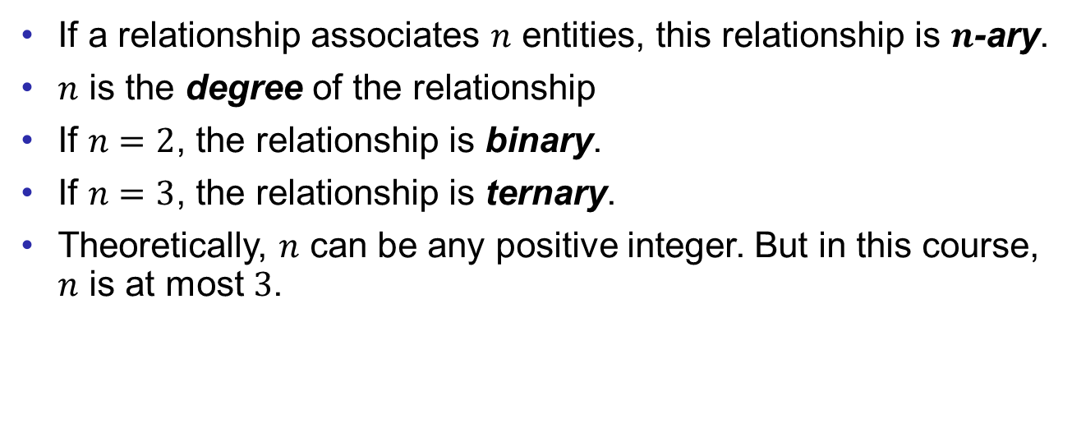
Multi-ary Relationship
Design Process
Entity Sets
Attributes
Relationship Sets
If a relationship associates $n$ entities, this relationship is $n$-ary.
$n$ is the degree of the relationship
If $n=2$, the relationship is binary.
If $n=3$, the relationship is ternary.
Theoretically, $n$ can be any positive integer. But in this course, $n$ is at most $3$.

Slide 25
Multi-ary Relationship
Design Process
Entity Sets
Attributes
Relationship Sets
For the following example, a ternary relationship is reasonable.
This example models that some students are enrolled in some courses which are instructed by some teachers.
id
name
course_name
credits
phone
student
enroll
course
id
name
course_code
year
major
GPA
domain
phone
instructor
course_number
title
major
salary

Slide 26
Roles
Design Process
Entity Sets
Attributes
Relationship Sets
Sometimes multiple entities of the same type can participate a same relationship.
Suppose we want to express “some courses are the prerequisite of some other courses”.
For example, before taking the database course, one must pass the C program course.
To model this example, ER diagram allows an entity set to link with a relationship set multiple times.
Roles are written in text, to express how the entities are participating the relationship.
course_name
credits
successor
course
pre_req
predecessor
course_code
domain
course_number

Slide 27
Attributes for Relationship Sets
Design Process
Entity Sets
Attributes
Relationship Sets
Sometimes people are also interested in some information about relationships.
In the “students borrow books” example, we also want to know when the book is borrowed, when the book is returned, and how long the book is kept by the student.
This information does not belong to students or books. It is about the association.
Thus, in this case, the relationship set can also have some attributes.
date_of_borrow
date_of_return
id
name
ISBN
phone
student
borrow
book
year
major
author
GPA
duration
title

Slide 28
Derived Attributes
Design Process
Entity Sets
Attributes
Relationship Sets
In the previous example, the attribute duration is in a dashed ellipse because it is a derived attribute.
If one knows the date of borrow and the date of return, then the duration can be calculated from the two values.

Slide 29
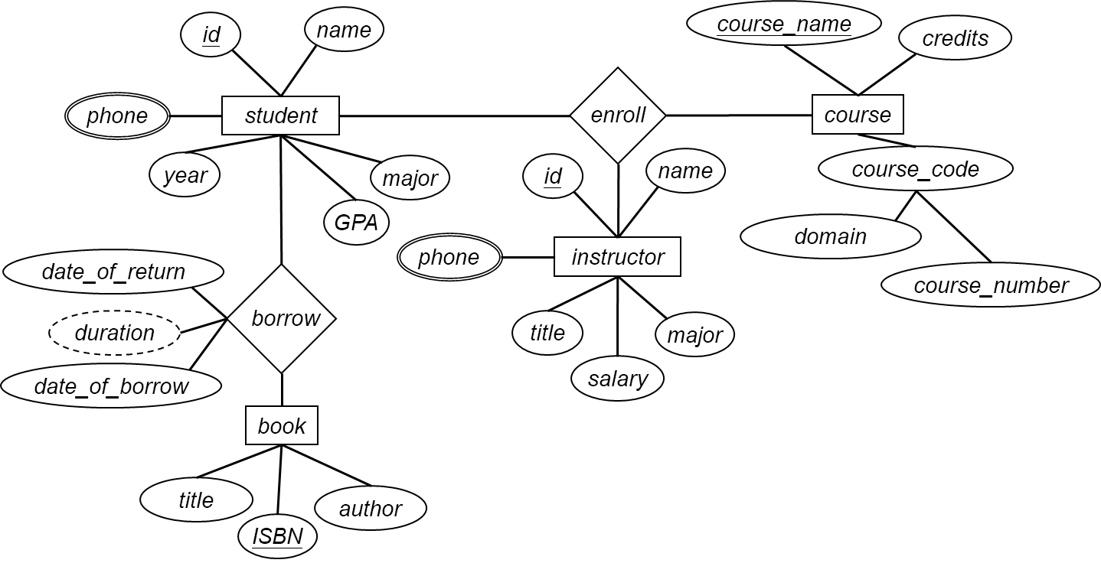
Example
Design Process
Entity Sets
Attributes
Relationship Sets
Summarizing the examples.
Sometimes designers have to reallocate the positions of some components of the ER diagram to make it beautiful.

Slide 30
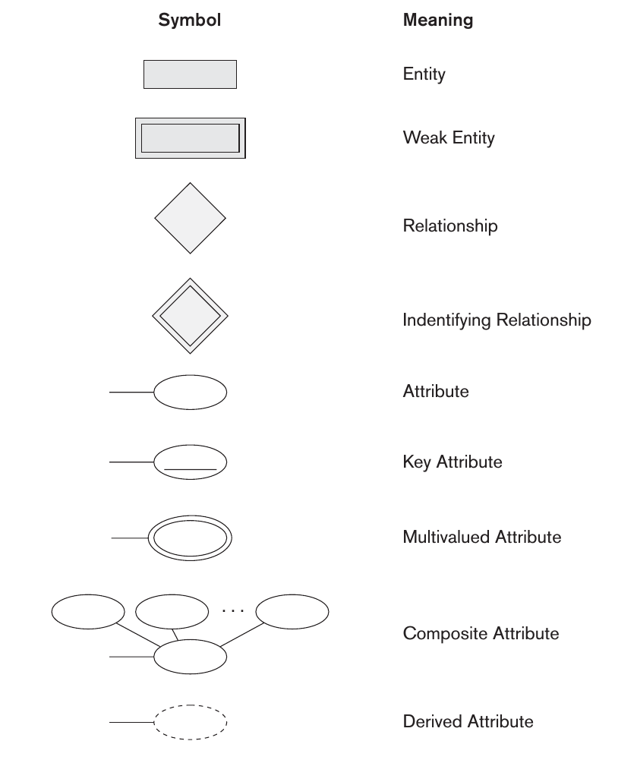
Summary
Design Process
Entity Sets
Attributes
Relationship Sets

Slide 31
Exercises
Design Process
Entity Sets
Attributes
Relationship Sets
Based on the ER diagram on page 29, model the following features.
Programs, which have program codes, program names, and the division that each program belongs to.
Students have majors.
Instructors work for some programs.
Every program has a program director, who is also an instructor.
Courses are offered by programs.

Slide 32
End of Lecture 2
Design Process
Entity Sets
Attributes
Relationship Sets

